Slide 1
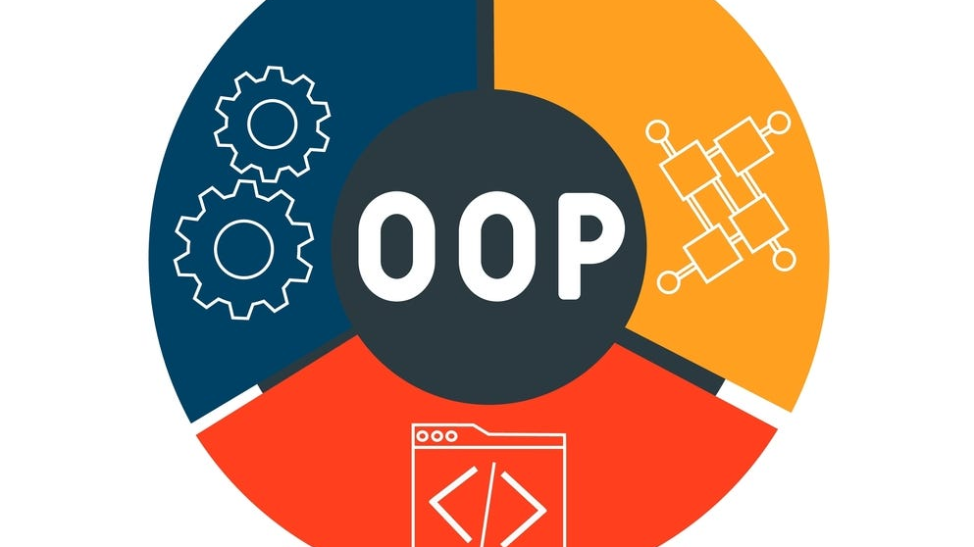
OOP Pillars
(OOP)

Slide 2

OOP Pillars
Encapsulation
Inheritance
Polymorphism
Abstraction

Slide 3
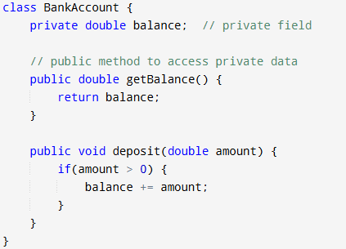
Encapsulation
Encapsulation is the concept of bundling data and methods that operate on that data within a single unit or class. This restricts direct access to some of the object’s components, which is useful for hiding the internal state and ensuring controlled access.

Slide 4
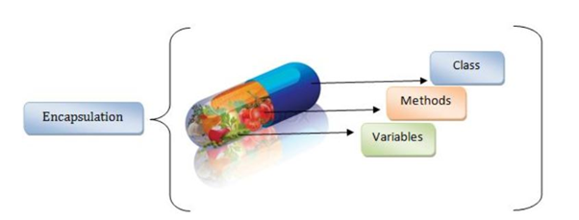
Concept
Encapsulation uses access modifiers like Private, Protected, and public to define which parts of a class are accessible from outside.
It creates a protective barrier around an object's data, enforcing access through getter and setter methods. This approach prevents external code from tampering directly with internal data, ensuring data integrity.

Slide 5
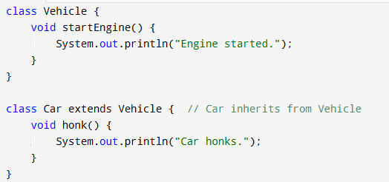
Inheritance
Inheritance allows a class to inherit properties and behavior (methods) from another class. This mechanism is key for creating a hierarchical relationship between classes, enabling code reuse and enhancing modularity.

Slide 6
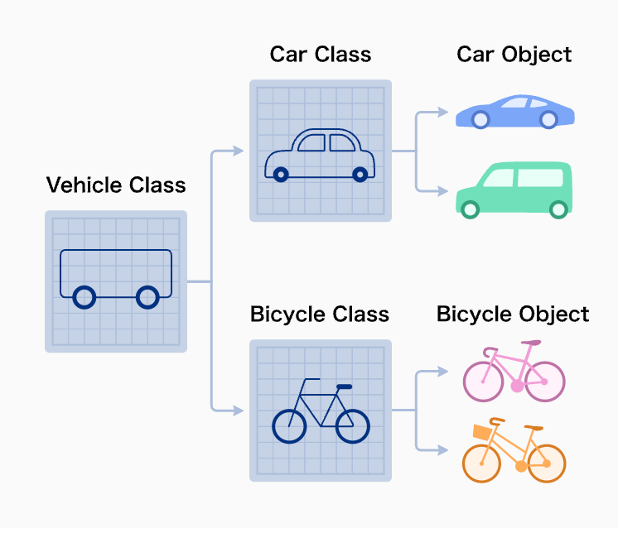
Concept
Inheritance establishes an is-a relationship. For instance, if Car inherits from Vehicle we can say "A car is a vehicle."
It encourages reusability and maintainability by allowing shared code in a base class to be reused by derived classes.
Types of inheritance include single inheritance (one parent class) and Multilevel Inheritance (a chain of inheritance).
Here, the Car class inherits the startEngine() method from the vehicle class, demonstrating inheritance by reusing existing functionality.

Slide 7
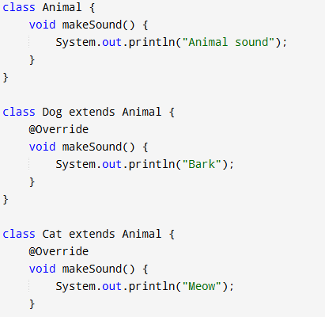
Polymorphism
Polymorphism enables objects of different classes to be treated as objects of a common superclass. It allows the same method to do different things based on the object it is acting upon, achieving flexibility and dynamic behavior in code.

Slide 8
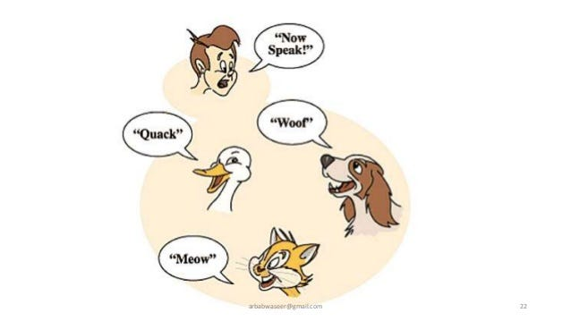
Concept
The word "polymorphism" means "many shapes"—a polymorphic method or object can take multiple forms.
There are two main types:
Compile-time Polymorphism (Method Overloading): Achieved by defining multiple methods with the same name but different parameters.
Runtime Polymorphism (Method Overriding): Achieved by defining a method in a subclass that overrides a method in its superclass.

Slide 9
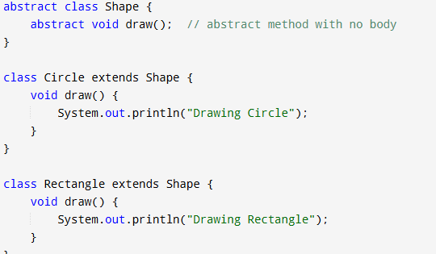
Abstraction
Abstraction is the concept of hiding complex details from the user, showing only essential information. This makes software easier to interact with by reducing complexity and focusing on high-level operations.

Slide 10
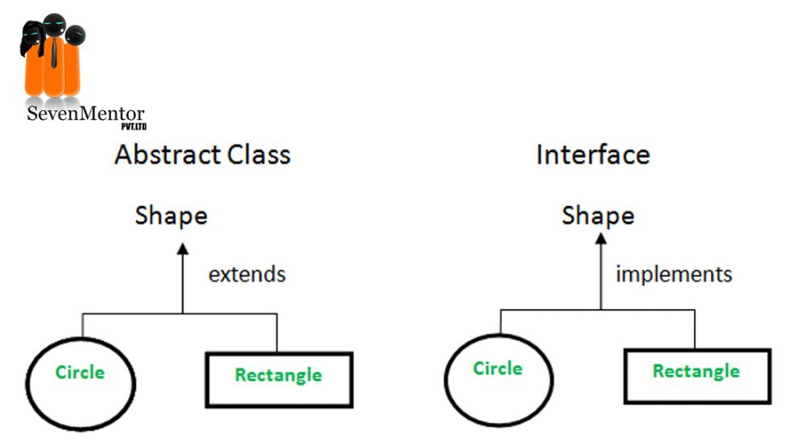
Concept
Abstraction focuses on defining what an object does rather than how it does it.
It’s commonly implemented using abstract classes and interfaces, which define methods that subclasses or implementing classes must provide.
It allows developers to work at a higher level, focusing on interactions without needing to understand implementation details.

Slide 11

Summary
The four pillars of OOP—encapsulation, inheritance, polymorphism, and abstraction—create a modular, reusable, and maintainable structure for developing efficient software systems.

